Slide 1
PART IV. High-level awareness o f broader landscape in causal reasoning

Slide 2
Outline
Discovery of causal relationships from data
Heterogeneous treatment effects
Machine learning, representations and causal inference
Reinforcement learning and causal inference
“Automated” causal inference

Slide 3
Causal discovery

Slide 4
Effects of causes and causes of effects
We discussed causal inference: effects of causes
But a complementary question is causal discovery
[Local] Causes of effects
[Global] Mapping out causal mechanisms
In general, a harder problem.
See Causation [Spirtes (2000)] and Elements of Causal Inference (Scholkopf et al. 2017).

Slide 5
Heterogenous treatment effects

Slide 6
Average causal effect does not capture individual-level variations
Stratification is one of the simplest methods for heterogenous treatment by strata
Typical strata are demographics.
Need more data to statistically detect differences
For high-dimensions, can use machine learning methods like random forests [Athey and Wager, 2015]

Slide 7
Machine learning and causal inference

Slide 8
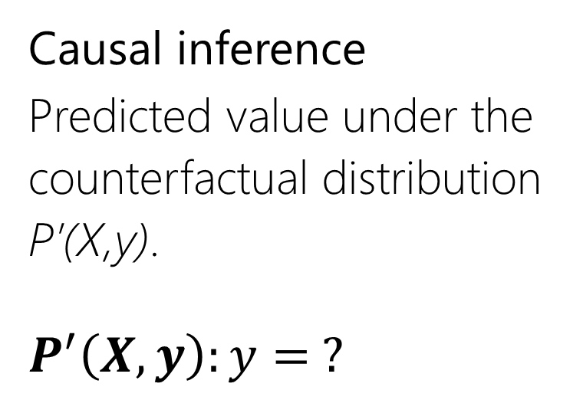
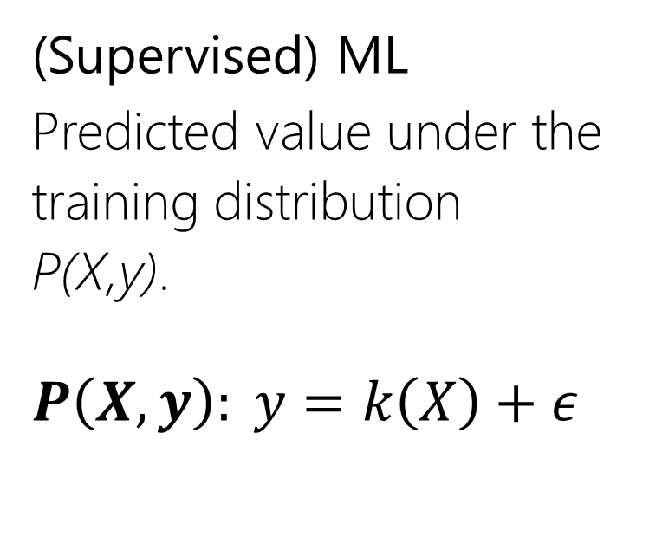
Causal inference as a (counterfactual) prediction problem
Causal inference ⬄ robust prediction
(Supervised) ML
Predicted value under the
training distribution
P(X,y).
$$P\left(X,y\right): y=k\left(X\right)+ε$$
Causal inference
Predicted value under the
counterfactual distribution
P’(X,y).
$$P^{′}\left(X,y\right):y= ?$$

Slide 9
Causal inference: A special kind of domain adaptation
X
X
X
T
Y
T
Y
T
Y
P(Y,T,X)
Observed data
P*(Y,T,X)
Randomized experiment
P**(Y,T,X)
Another domain

Slide 10
Predicting the counterfactual ⬄ Causal Inference
Predicting Individual treatment effects can be considered as domain adaptation
--Use regularization and transformation of input features [Johansson 2016]
Generalizing prediction to new domains
-- Selection bias or covariate shift [Barenboim and Pearl 2013]
-- If predictive model generalizes to new domains, can be considered “causal” [Peters et al. 2015]

Slide 11
Causal inference and machine learning
Machine learning
Use causal inference methods for robust, generalizable prediction.
Causal inference
Use ML algorithms to better model the non-linear effect of confounders, or find low-dimensional representations.
In general, be wary of methods that have not been empirically tested, especially ones that you do not understand.

Slide 12
Reinforcement learning and causal inference

Slide 13
Generalizing a randomized experiment
A/B test
Multi-Armed Bandits
Markov Decision Processes
POMDPs

Slide 14

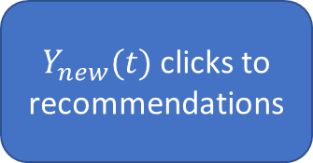
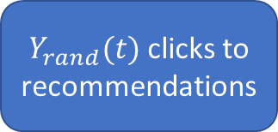
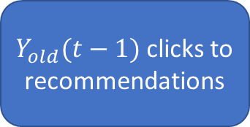
Efficient randomized experiment: Multi-armed bandits
Two goals:
Show the best known algorithm to most users.
Keep randomizing to update knowledge about competing algorithms.
“Explore and Exploit” strategy
Old Algorithm
$Y_{old}(t−1)$ clicks to recommendations
…
Current-best Algorithm
Random Algorithm
$Y_{new}(t)$ clicks to recommendations
$Y_{rand}(t)$ clicks to recommendations
Most users
Other users

Slide 15
Algorithm: ɛ-greedy multi-armed bandits
Repeat:
(Explore) With low probability ɛ, choose an output item randomly.
(Exploit) Otherwise, show the current-best algorithm.
Use CTR results for Random output items to train new algorithms offline.

Slide 16
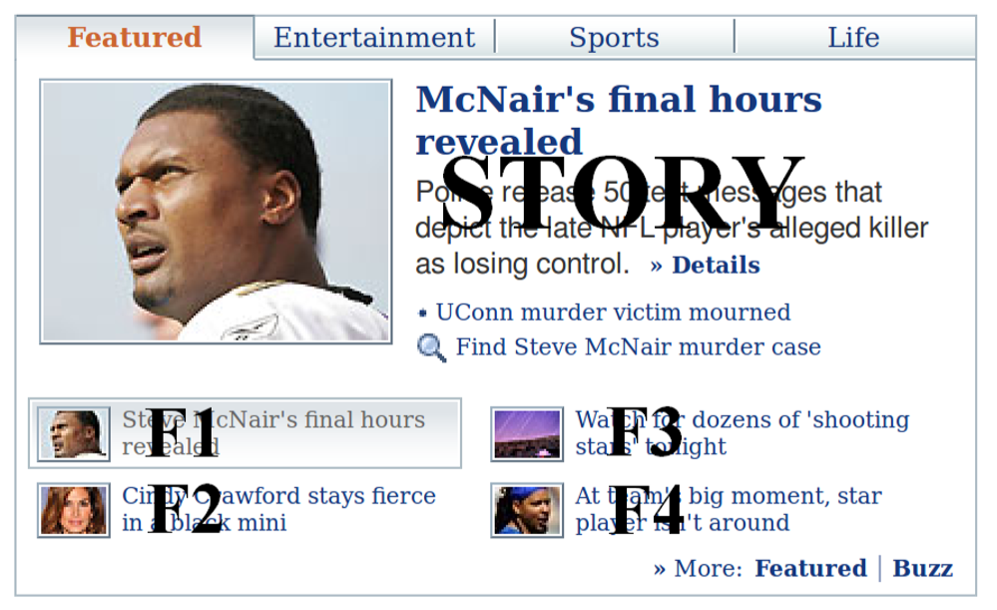
Practical Example: Contextual bandits on Yahoo! News
Actions: Different news articles to display
A/B tests using all articles inefficient.
Randomize the articles shown using ɛ-greedy policy.
Better: Use context of visit (user, browser, time, etc.) to have different current-best algorithms for different contexts.
Li-Chu-Langford-Schapire (2010)

Slide 17
Many of these techniques can be combined

Slide 18
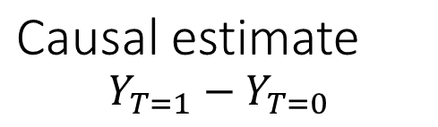
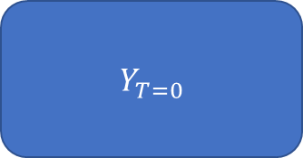
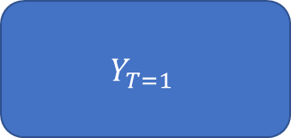
Remember, we are always looking for the ideal experiment with multiple worlds
Causal estimate
$$Y_{T=1}−Y_{T=0}$$
$Y_{T=0}$
$$Y_{T=1}$$
Cloned user

Slide 19
Example: Randomization + Instrumental Variable
Treatment example: You cannot randomize who exercises, but maybe can provide incentives to join the gym.
Algorithm example: You cannot remove recommendations at random, but could advertise a focal product to a random subset of people on the homepage.

Slide 20
Conclusions

Slide 21
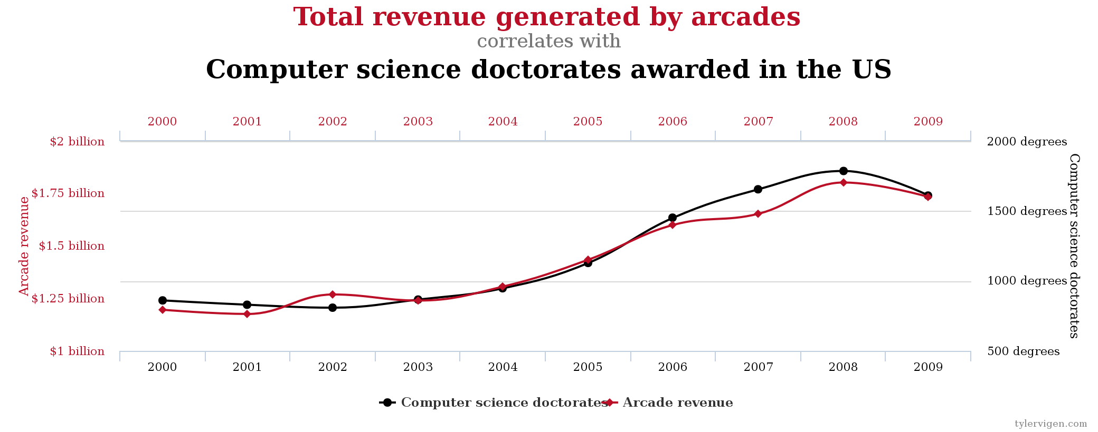
Causal inference is tricky Correlations are seldom enough. And sometimes horribly misleading. Always be skeptical of causal claims from observational any data. More data does not automatically lead to better causal estimates.
http://tylervigen.com/spurious-correlations

Slide 22
Causal inference: Best practices
Always follow the four steps: Model, Identify, Estimate, Refute.
--Refute is the most important step.
Aim for simplicity.
--If your analysis is too complicated, it is most likely wrong.
Try at least two methods with different assumptions.
--Higher confidence in estimate if both methods agree.

Slide 23
Thank you!
Emre Kiciman, Amit Sharma (Microsoft)
@emrek, @amt_shrma
Tutorial and other resources will be posted at: http://causalinference.gitlab.io
DoWhy library can be accessed at http://causalinference.gitlab.io/dowhy

